Slide 1

Toolkit Doc19 Upper Arm
May 8, 2010

Slide 2
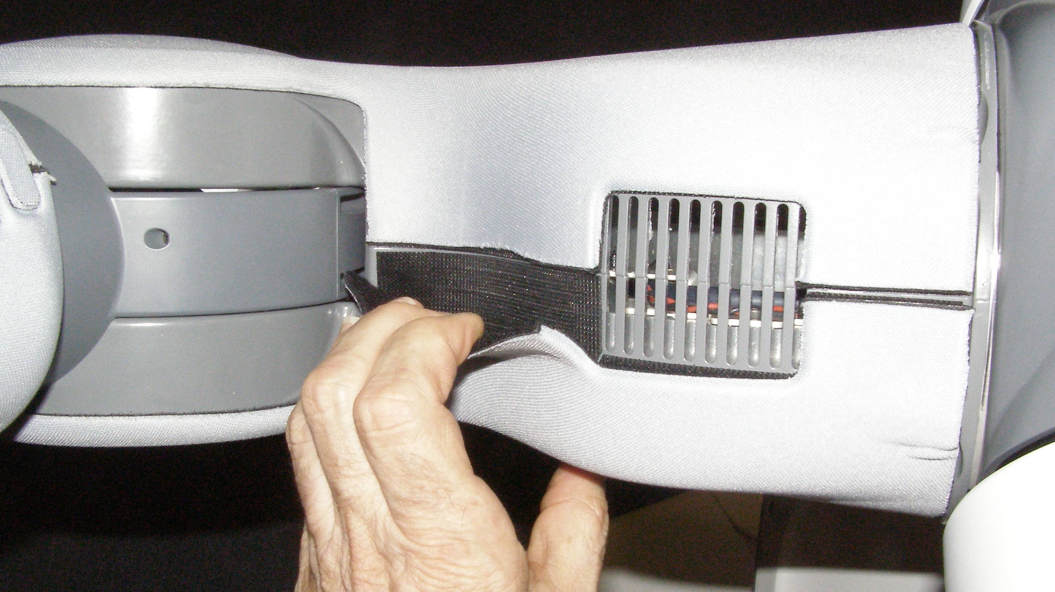
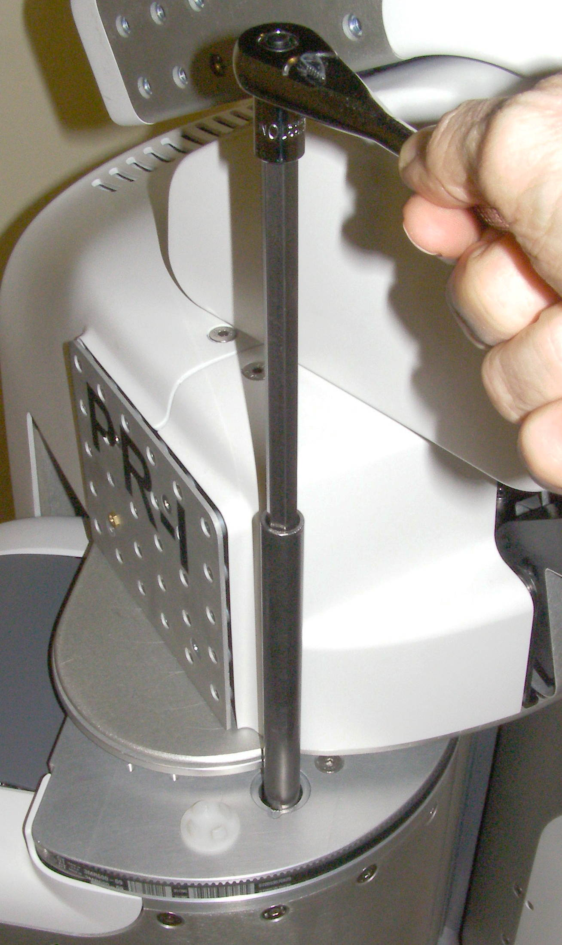

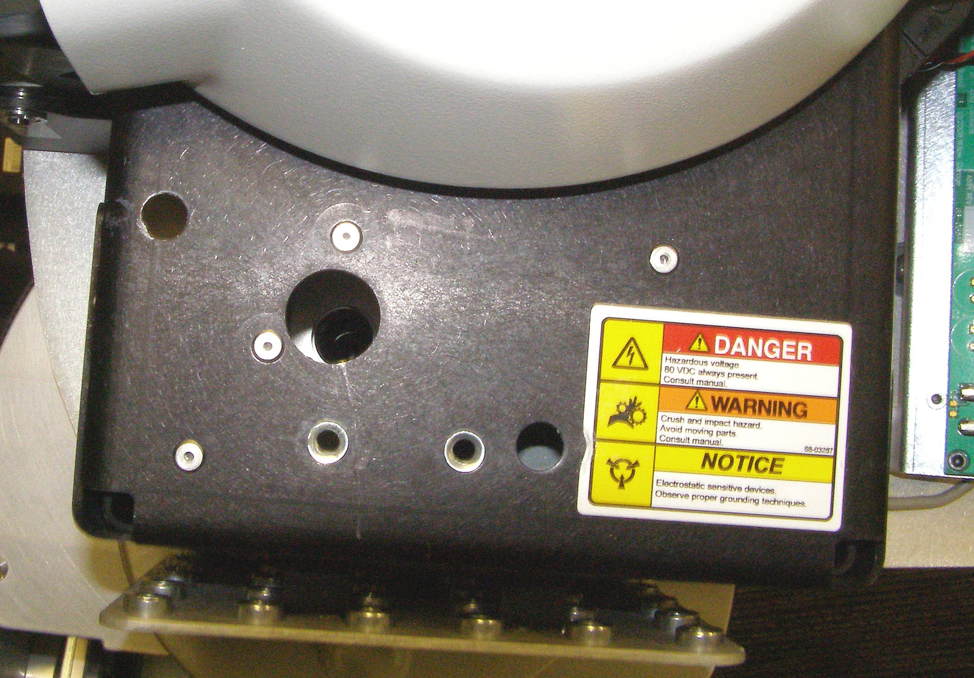
Upper Arm Removal (1)
Upper Arm, removal – 4139 (requires 2 people)
  Remove Upper Arm Outer Cover – 2545. It is strongly retained with Velcro. Peel the Cover off starting from the top edge. (Fig 1)
  Remove Fore Arm with Gripper.
  Remove Shoulder Covers.
  Remove Front and Rear Top Covers.
  Rotate the Arm so as to expose the Primary spring adjustment access hole cap. (Fig 2,3)
  Remove the cap with a small flathead screwdriver (not supplied). Insert the steel guide tube through the Primary access hole. Using the 10mm rod together with the 10mm 1/4 drive socket and the 1/4 drive ratchet wrench, turn the Primary adjustment counter-clockwise until it is fully backed off. (Fig 3)
  Rotate the Arm so as to align the Secondary adjustment access hole. The position required will be different from the left side to right side (Fig 4)
  First install the steel guide tube through the Secondary access hole making sure that it is bottomed out and protrudes about 1.5cm.
  Using the 10mm rod together with the 10mm 1/4 drive socket and the 1/4 drive ratchet wrench, turn the Secondary adjustment counter-clockwise until it is fully backed off. (Fig 5)
Fig 1
Tube
cap
Primary
Fig 2
Right
Fig 3
Secondary
Fig 4
Left
Primary
Secondary
Arm Gimbal Shaft
Fig 3
Fig 7

Slide 3

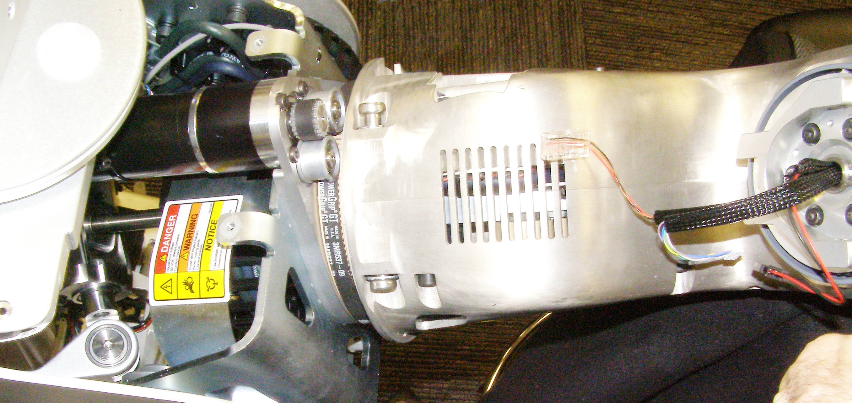
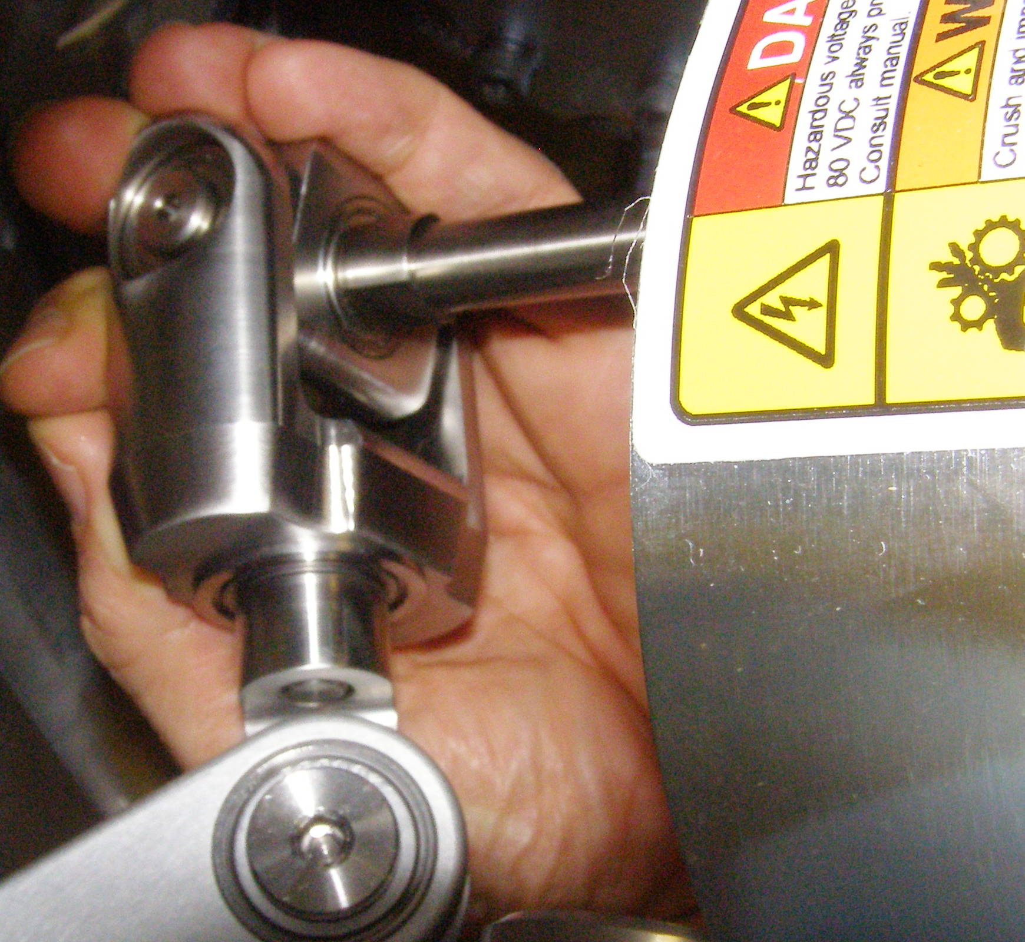
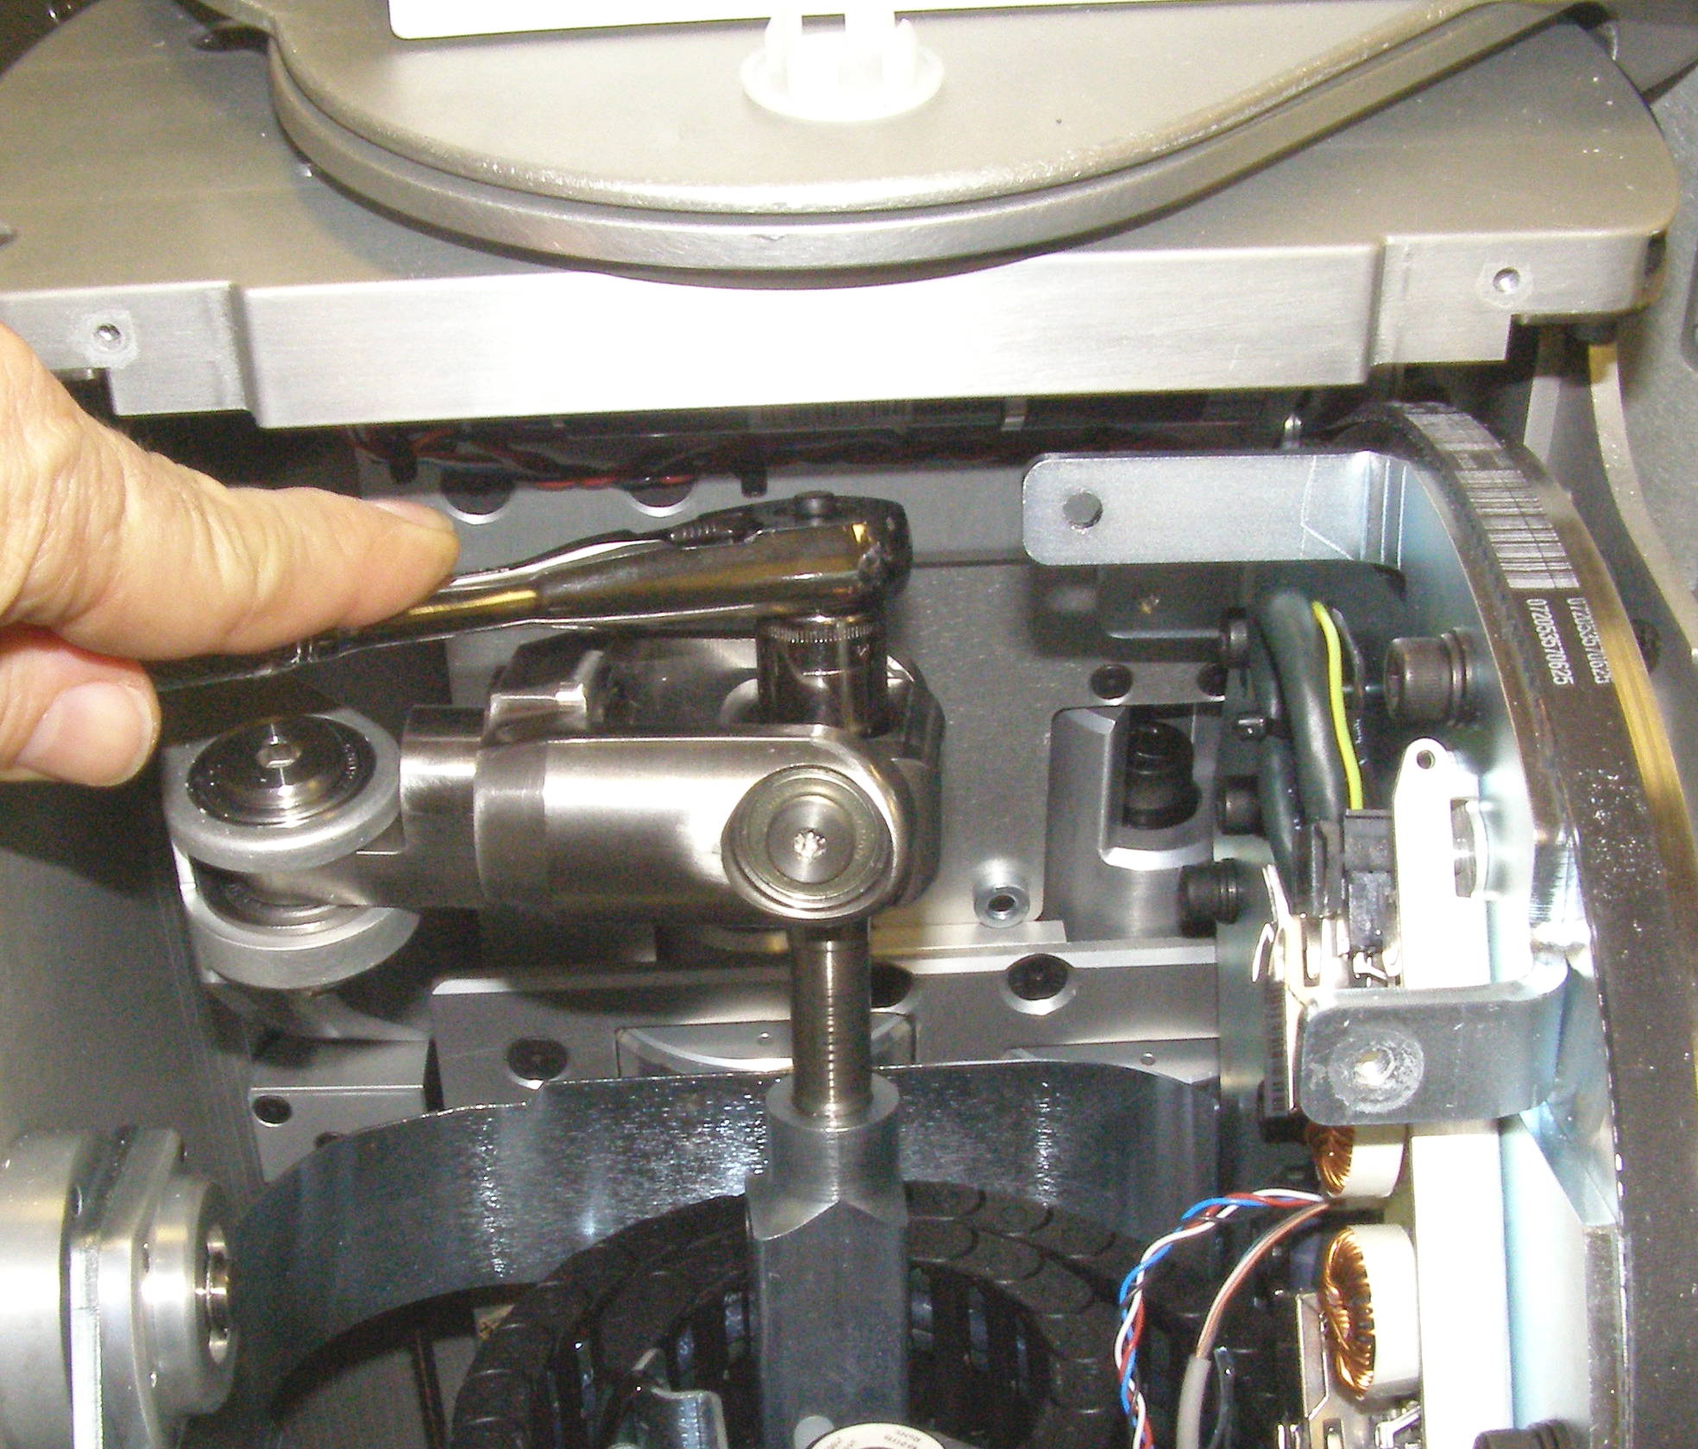
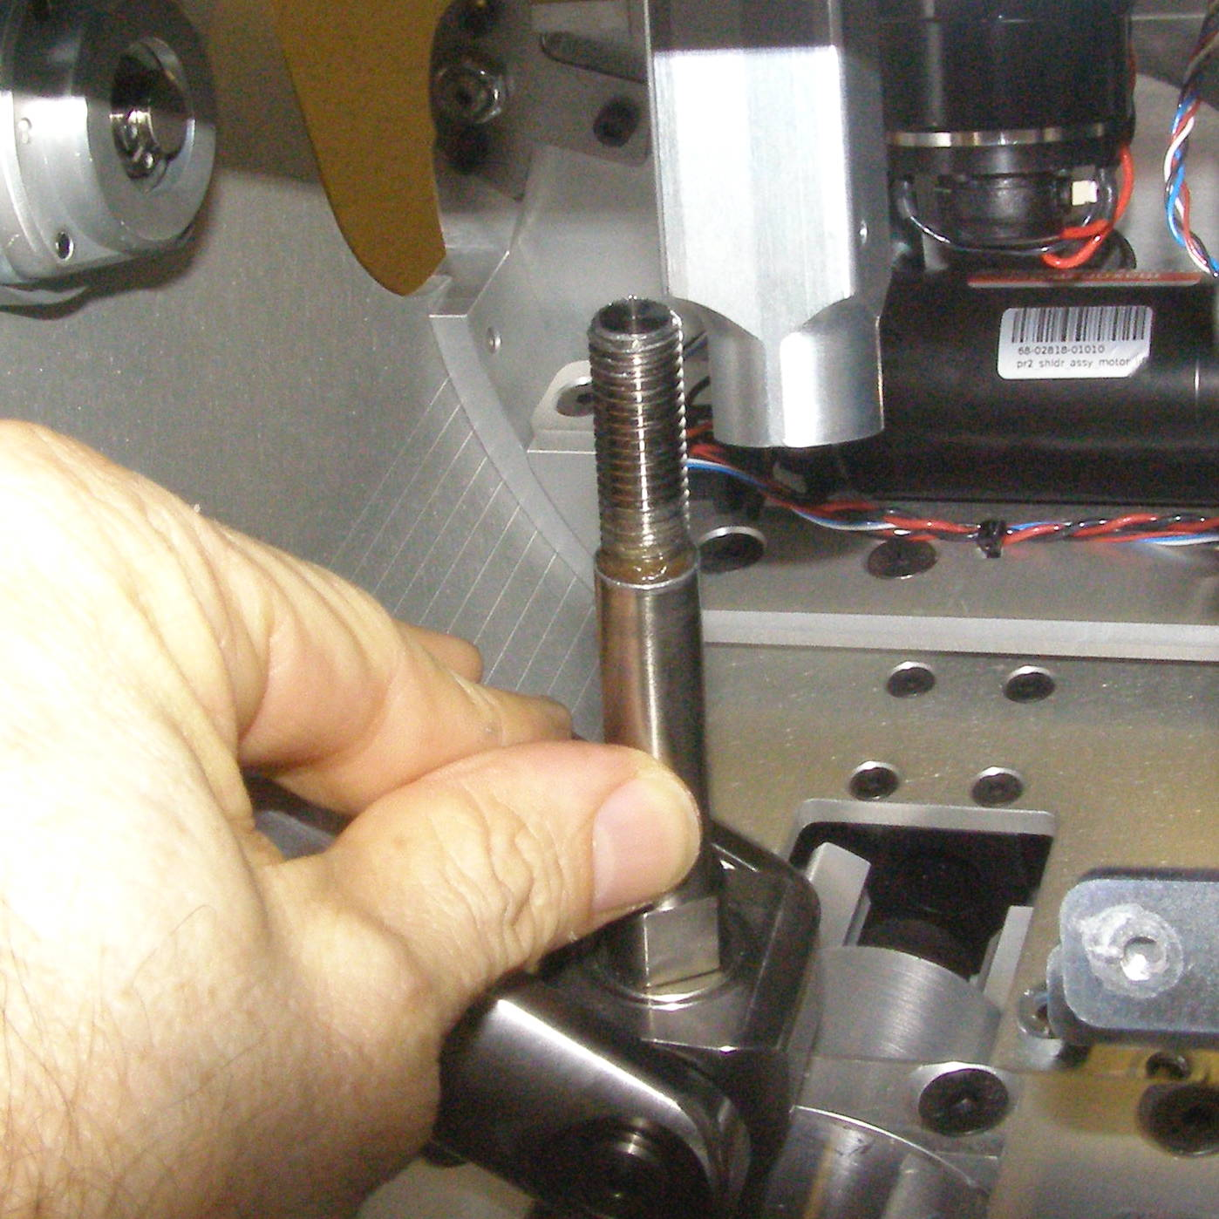
Upper Arm Removal (2)
Fig 7
towards robot
Fig 5
Align with motor
tube
  You may have wiggle the Arm Gimbal Shaft to get it out. (Fig 8,9)
  The Arm will continue to need to be supported until it is removed from the robot as allowing it to rest completely down can damage internal components.
  With the Arm lowered, using the ¼ drive ratchet wrench together with the ¼ drive 13mm socket, back out the Arm Gimbal Shaft by turning it counter-clockwise until the thread is disengaged. It will not come out of the square Counter Balance Shaft at this point. (Fig 5)
  To completely remove the Arm Gimbal Shaft, lift the Arm as high as it will go. Fully rotate the Fore Arm pivot so it is aimed towards the Robot.
  Rotate the Upper Arm so that it is lined up with the motor as shown to position the Arm Gimbal Shaft for maximum clearance on the inside for removal. (Fig 7)
Fig 6
Fig 8
Fig 9

Slide 4
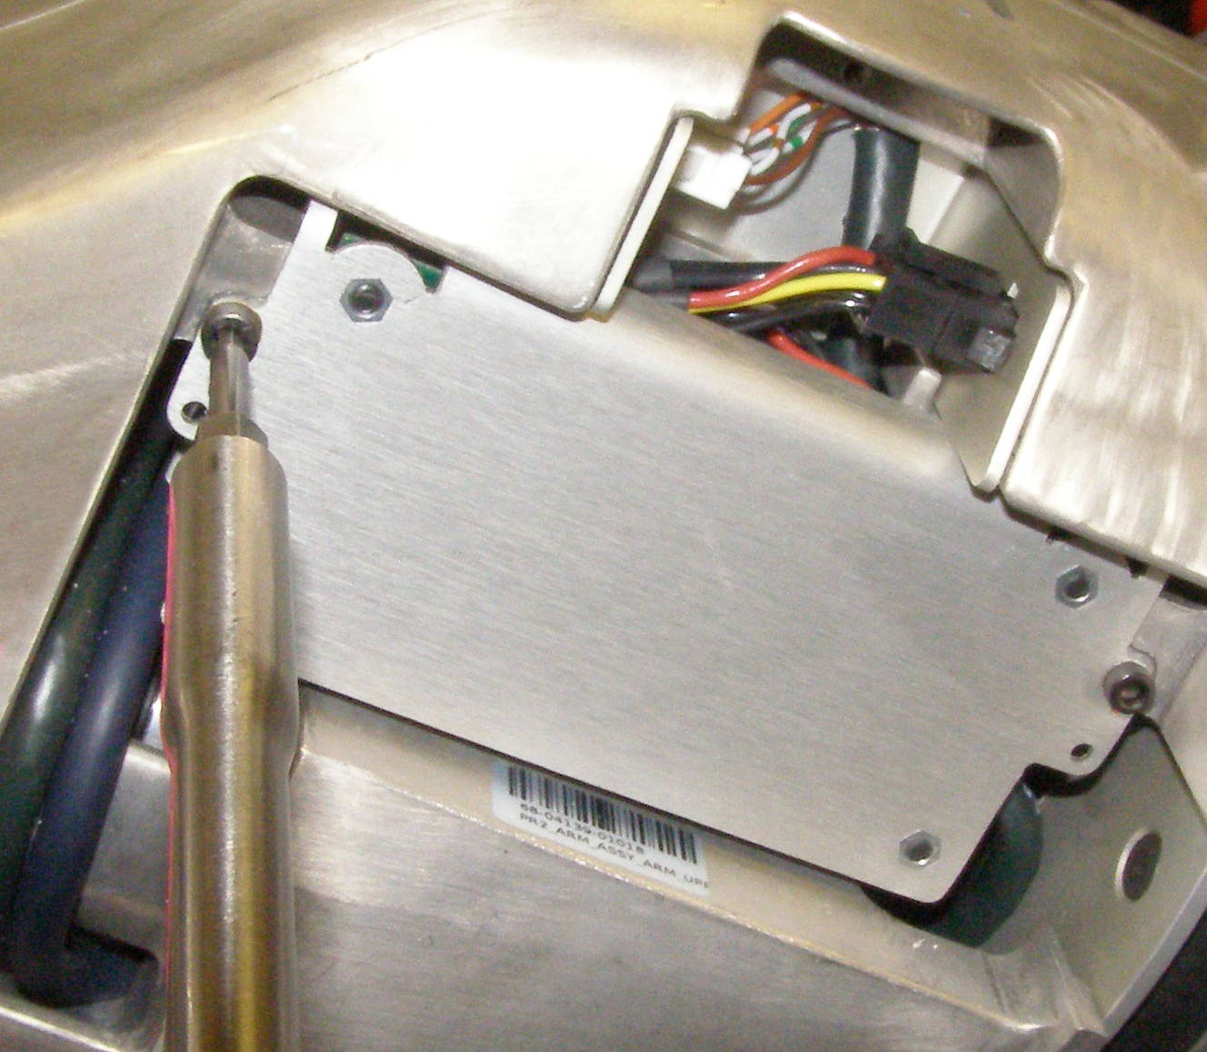
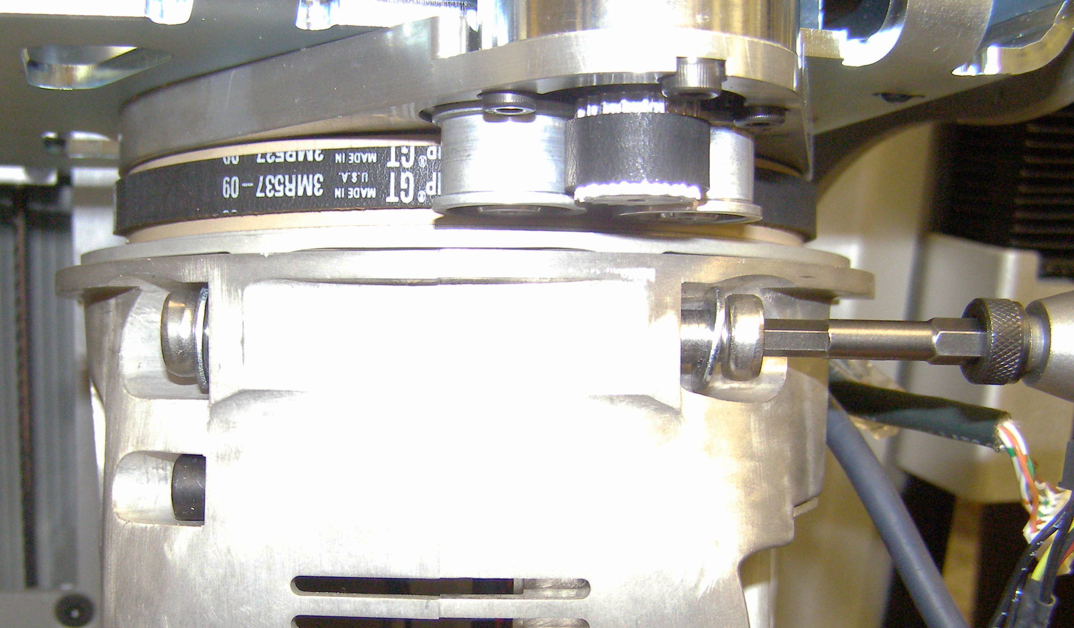
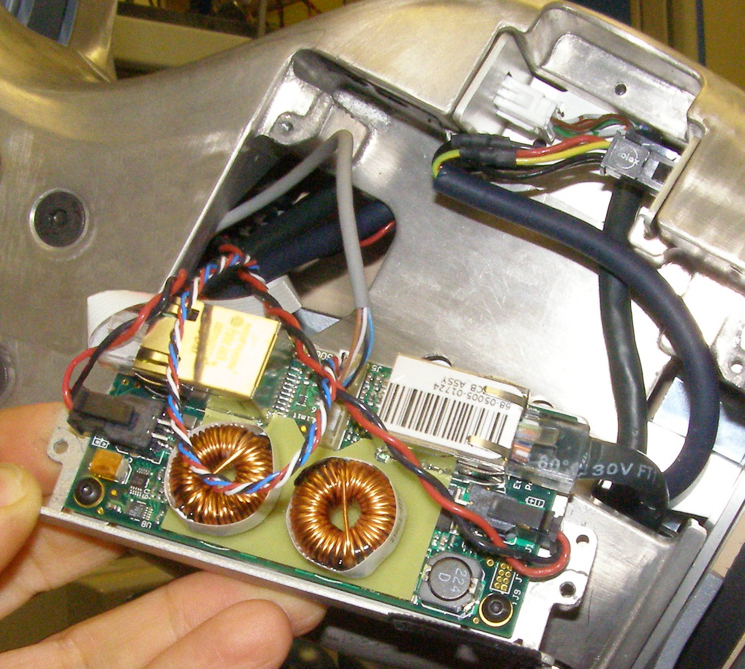
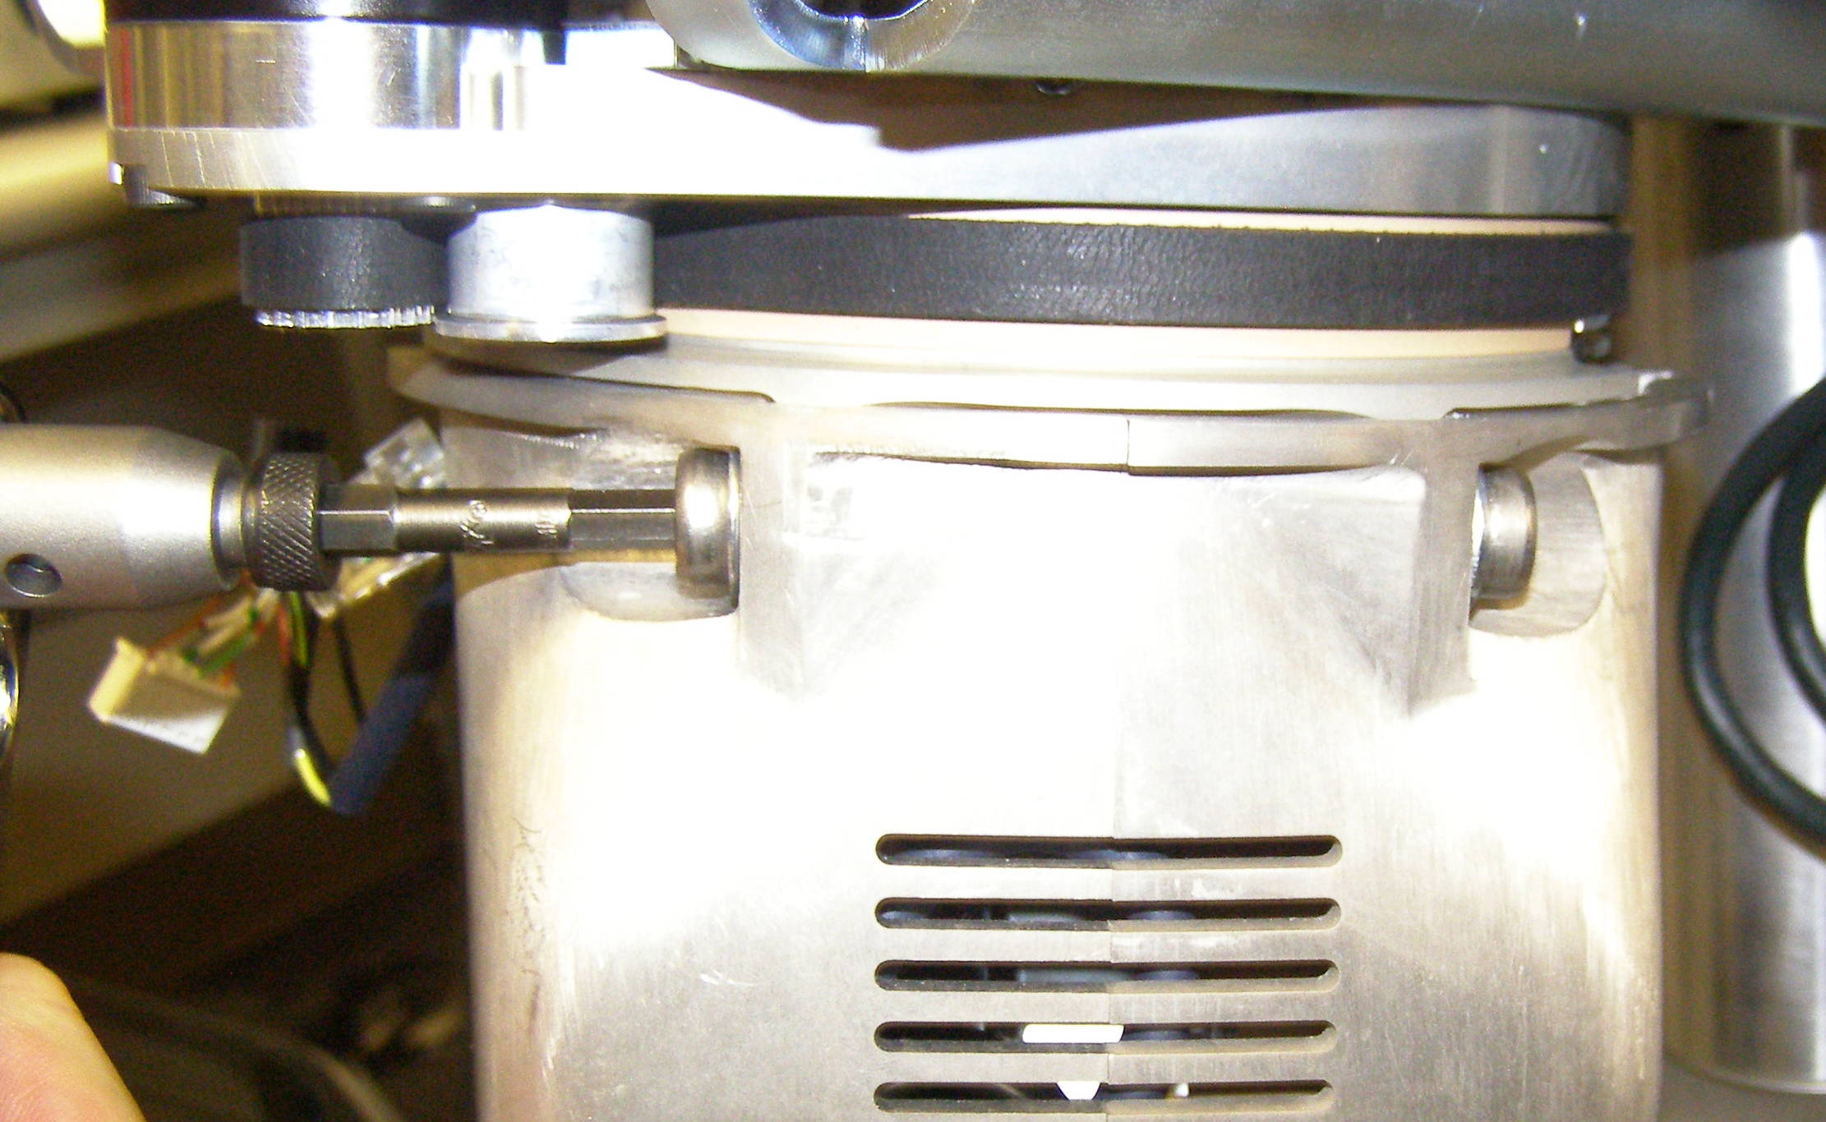
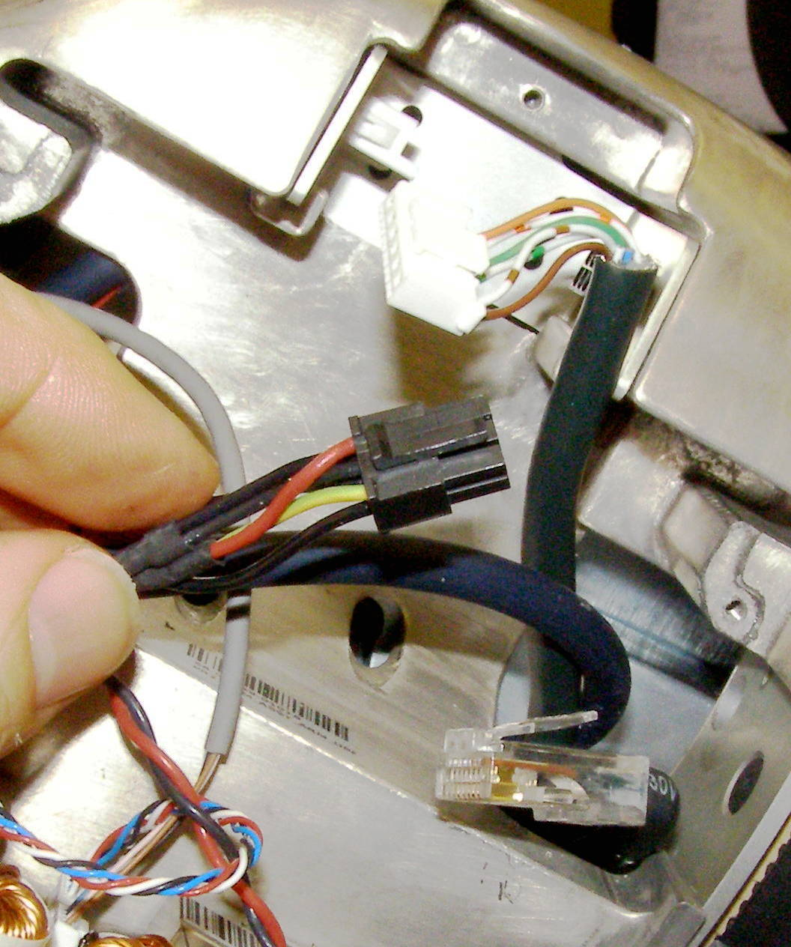
Upper Arm Removal (3)
  Using the 2.5mm bit with the T-handle driver, remove the 2 MCB Sled screws. 2009-06
  (Fig 10)
  Pivot the MCB Sled - 4286 out and disconnect the 3 cables as shown. (Fig 11,12)
  With one person still holding the Upper Arm, using the 5mm bit with the the hex to 3/8 drive adapter, and the 3/8 drive ratchet wrench, remove 4 screws, 2 on each side of the Arm. Be careful that the Fore Arm does not twist from it's mount as you release the screws. Carefully remove the Upper Arm keeping the square shaft away from everything as the Arm is removed. 2610 (Fig 13,14)
Fig 10
Fig 13
Fig 11
Fig 12
Fig 14

Slide 5
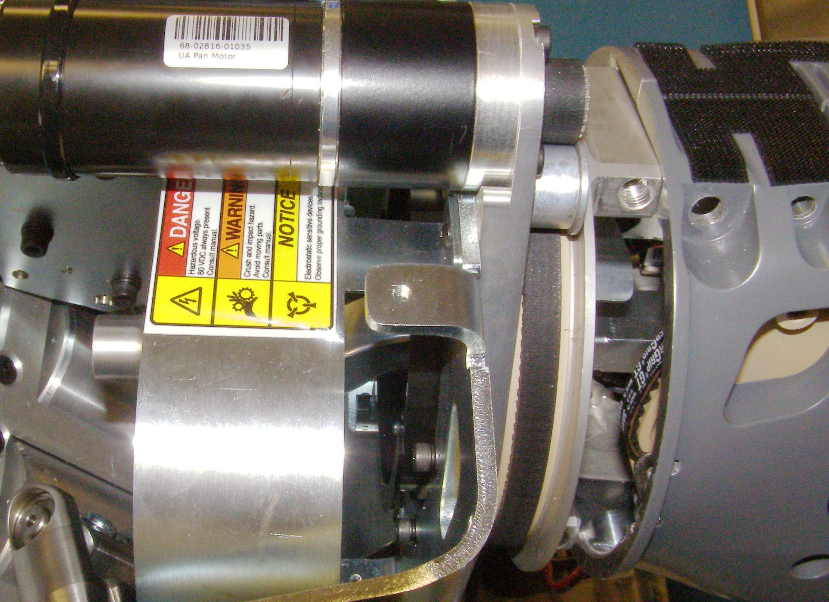
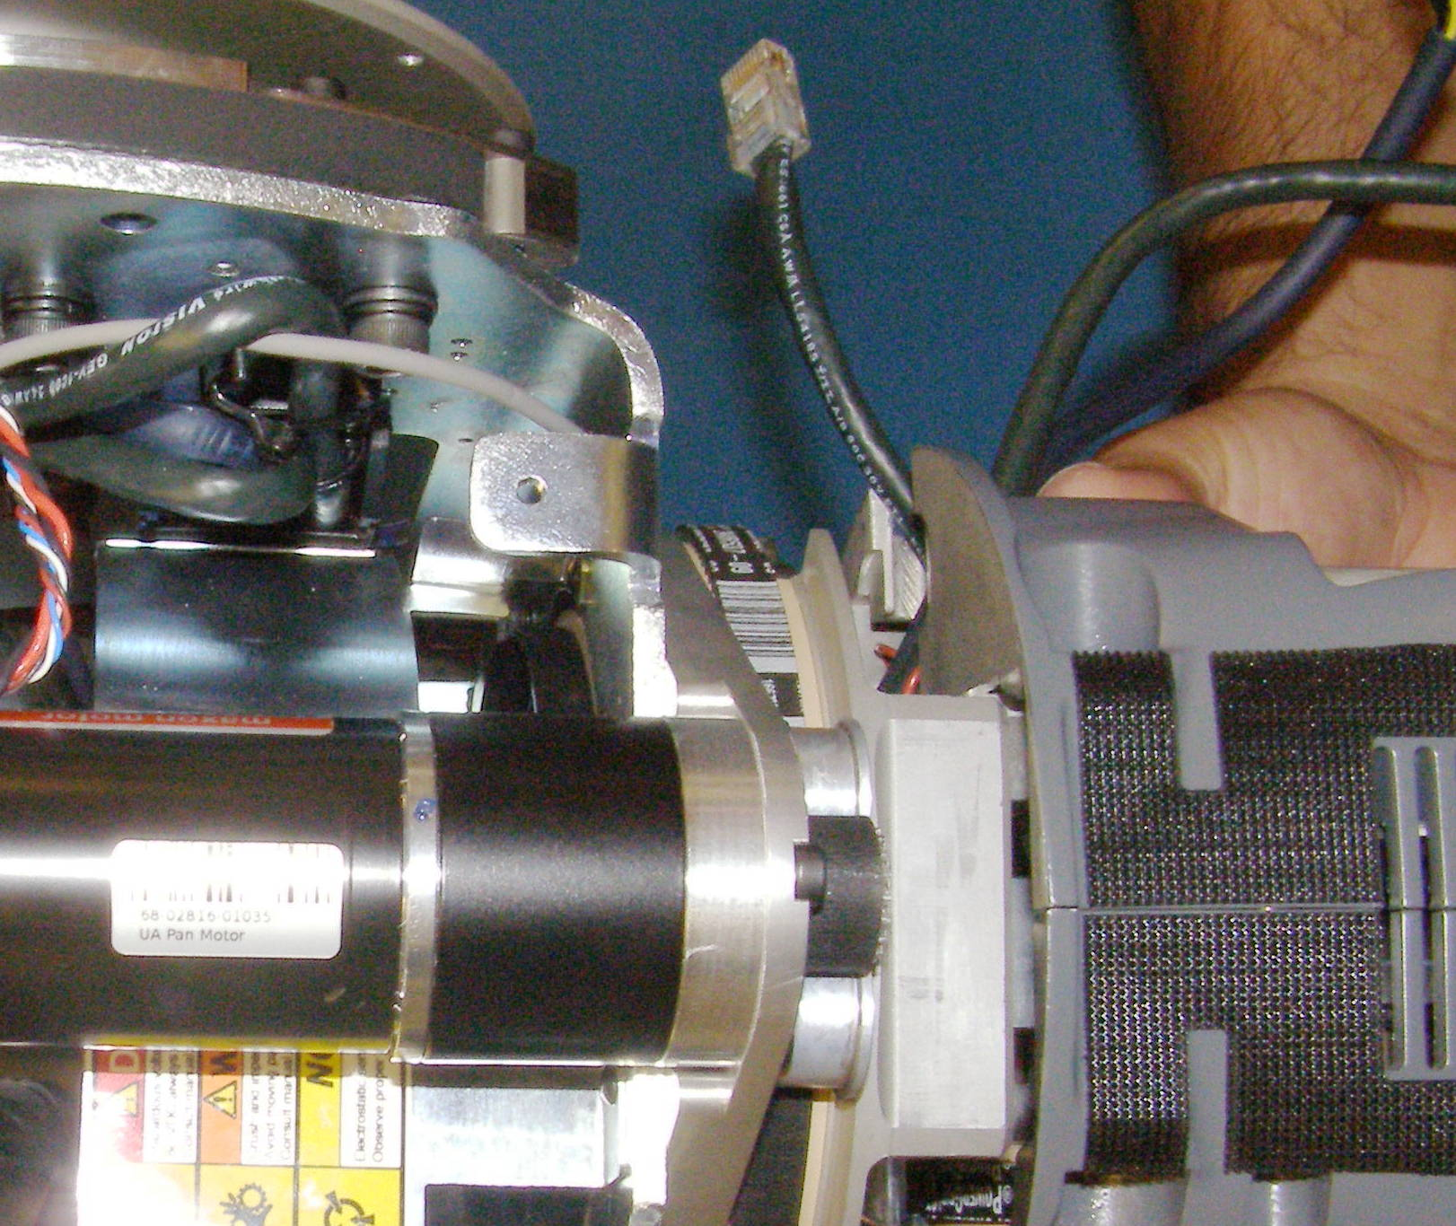
Upper Arm Install (1)
Upper Arm, install (requires 2 people)
  For a new Upper Arm, remove the tape covering the end of the square shaft and in all cases verify that there is grease visible in the bore.
  Carefully insert the Upper Arm assembly into the Shoulder making sure that the square shaft does not jam against the Arm Gimbal Shaft. (Fig 1,2)
  Using Loctite 248, combine the 5mm bit with the the hex to 3/8 drive adapter, and the Titan torque wrench, install the 4 Upper Arm mounting screws and torque to 11Nm.
  Plug in the 3 cables. (Fig 3)
Fig 3
shaft
  Pivot the MCB Sled into place being careful not to damage or pinch any of the cables. Using Loctite 248, install the 2 screws and torque to 1.36Nm using the Large torque driver.
  To reconnect the Arm Gimbal Shaft, lift the Arm as high as it will go. Fully rotate the Fore Arm pivot so it is aimed towards the Robot. Rotate the Upper Arm so that it is lined up approximately with the motor as shown to position the square shaft for maximum clearance to engage the Arm Gimbal Shaft. (Fig 4)
  Grasp the Arm Gimbal Shaft and maneuver the threaded end into the square shaft. You may have to wiggle and lift it slightly to get it to insert as far as possible. (Fig 5)
  Using the ¼ drive ratchet wrench together with the ¼ drive 13mm socket, thread in the Arm Gimbal Shaft by turning it clockwise to start the thread engagement.
  Slowly drop the Upper Arm as low as it will go with the Arm rotated towards the robot. (Fig 4)
Gimbal
Fig 1
Cables
Fig 4
Fig 2
towards robot
Align with motor

Slide 6
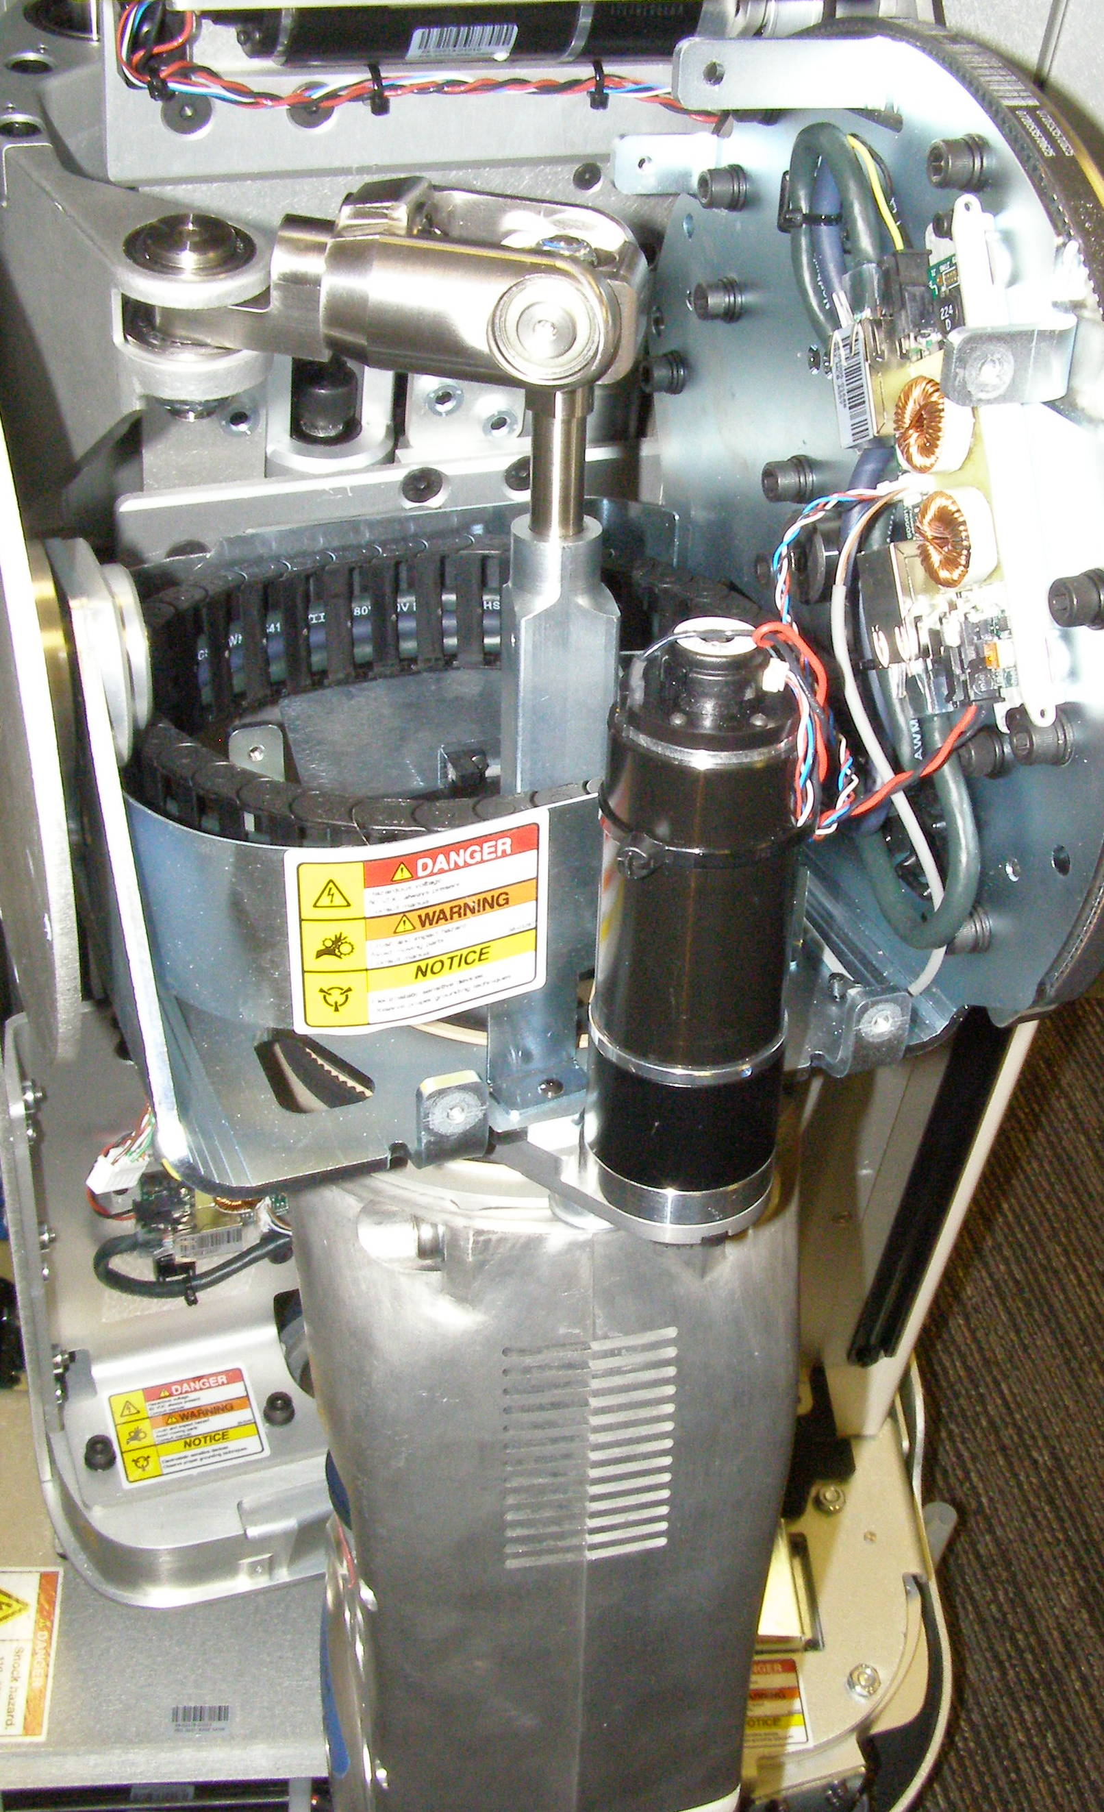
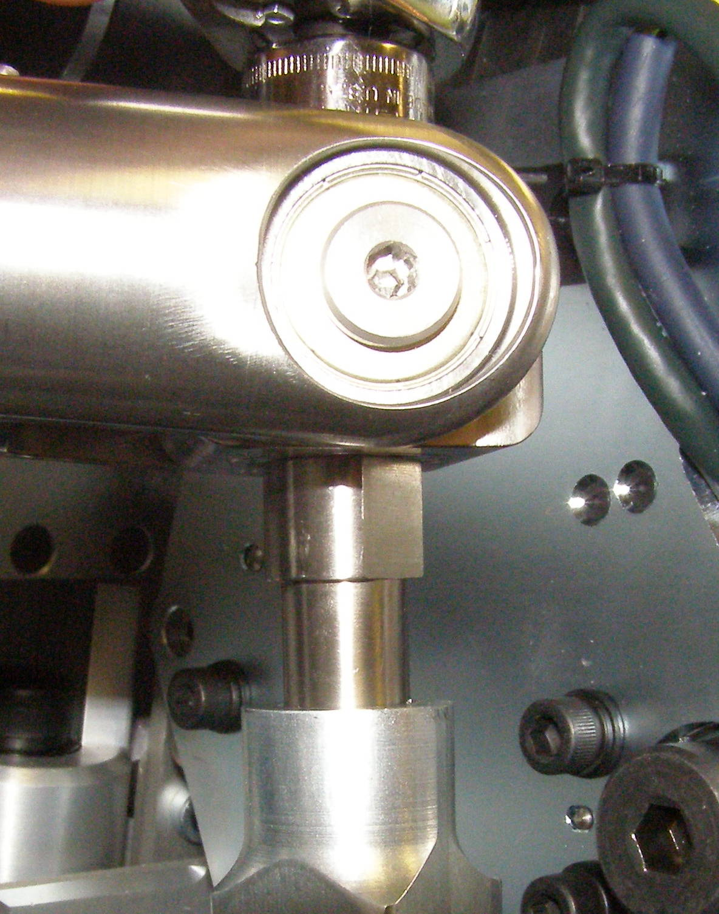
Upper Arm Install (2)
  Finish threading the Arm Gimbal Shaft until there is 1.5cm of round shaft visible.
  (Fig 7,8)
Lift
Fig 7
Fig 5
  Using the ¼ drive ratchet wrench together with the ¼ drive 13mm socket, thread in the Arm Gimbal Shaft by turning it clockwise to start the thread engagement.
  Slowly drop the Upper Arm as low as it will go with the Arm rotated towards the robot. (Fig 6)
Fig 8
Fig 6

Slide 7
Upper Arm Install (3)
  With one person holding up the Upper Arm,
  insert the steel guide tube through the Primary access hole. Using the 10mm rod together with the 10mm 1/4 drive socket and the 1/4 drive ratchet wrench, turn the Primary adjustment clockwise until it stops turning and is fully tensioned. Caution: without the Fore Arm attached the Upper will lift up during this procedure. (Fig 9)
  Attach the Fore Arm with the Gripper and install the Upper Arm Outer Cover.
  Follow the Counter Balance Adjustment procedure to complete installation.
Tube
Primary
Fig 9

